Slide 1
PROJECT 1 - CALCULATOR
Aakanksha Shewale

Slide 2
INTRODUCTION
This project involves creating an advanced calculator application using the Tkinter library in Python. Tkinter is a standard GUI toolkit in Python that provides a simple way to create windows, dialogs, and various user interface elements. The calculator will feature basic arithmetic operations as well as advanced mathematical functions, making it a versatile tool for various calculations.
2024
Project 1 - CALCULATOR
2

Slide 3
FEATURES:
Basic Arithmetic Operations:
The calculator includes the four fundamental arithmetic operations:
Addition (+): Adds two numbers. For example, 5 + 10 yields 15.
Subtraction (-): Subtracts one number from another. For example, 10 - 8 yields 2.
Multiplication (*): Multiplies two numbers. For example, 8 * 5 yields 40.
Division (/): Divides one number by another. For example, 12/3 yields 4.0.
Advanced Mathematical Operations
In addition to basic arithmetic, the calculator supports:
Square (^): Computes the square of a number. For example, 8^3 calculates 512.
Square Root (sqrt): Computes the square root of a number. For example, sqrt9 calculates 3.0.
Cube (^): Computes the cube of a number. For example, 2^3 calculates 8.
User Interaction
The calculator provides intuitive controls for user interactions:
Clear (C): Resets the display to an empty state, allowing the user to start a new calculation.

Slide 4
PROJECT STRUCTURE:
Import Libraries:
tkinter: This library is used for creating the graphical user interface (GUI). It provides tools to create windows, buttons,
and other interactive elements.
math: This library is used for mathematical operations like square roots, which are not directly available in basic arithmetic operations.
Initialize GUI:
Display Area: An Entry widget is used as the main area where users can input their expressions and view results. This
widget supports large font sizes and a clear border to enhance usability.
Define Buttons:
Buttons are arranged in a grid layout and provide functionality for:
Digits (0-9): To input numbers.
Operators (+, -, *, /): To perform basic arithmetic operations.
Special Operations (sqrt, ^2, ^3): For advanced calculations.
Functional Buttons (=, C): To calculate results, or clear the display.
4. Create Buttons:
Buttons are created and placed in the GUI using Tkinter’s Button widget. Each button is associated with a specific function, such as appending its label to the input or executing a calculation.

Slide 5
PROJECT STRUCTURE:
Button Click Handling:
When a button is clicked, the following actions are performed:
Evaluate Expression: When the = button is pressed, the calculator evaluates the current input expression. It uses functions to handle both standard and advanced mathematical operations.
Clear Display: The C button clears all input from the display.
Append Text: Other buttons append their respective labels to the current input.
Expression Evaluation:
Expressions are evaluated based on their content:
Square Root Calculation: Recognized by the sqrt keyword.
Square Calculation: Recognized by the ^2 keyword.
Cube Calculation: Recognized by the ^3 keyword.
Standard Arithmetic: Handled using Python’s eval() function for expressions involving basic operators.
7. Main Loop:
The main loop initializes the Tkinter window and starts the event loop, which keeps the application running and
responsive to user inputs.

Slide 6
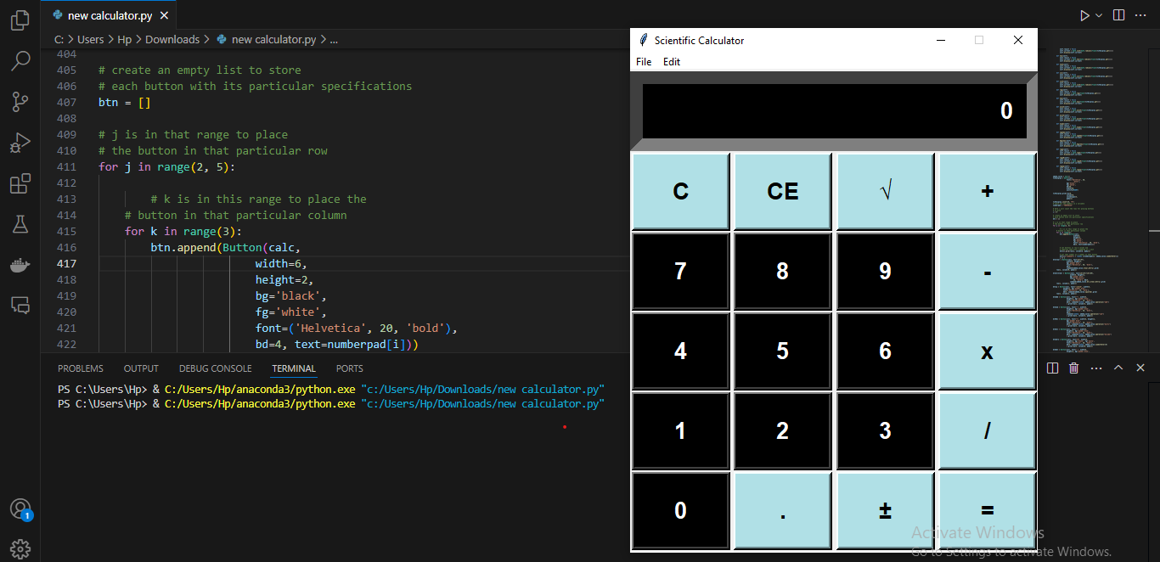
OUTPUT EXAMPLES:
Basic Arithmetic Operations:
Example Input: 2 + 3
Example Input: 7 * 6
Result: 5
Result: 42
Advanced Mathematical Operations:
Square Root Calculation:
Example Input: sqrt25
Example Input: sqrt16
Result: 5.0
Result: 4.0
Square Calculation:
Example Input: 5^2
Example Input: 4^2
Result: 25
Result: 16
Cube Calculation:
Example Input: 3^3
Example Input: 2^3
Result: 27
Result: 8

Slide 7
CONCLUSION
This advanced calculator project illustrates how to use Tkinter to create a versatile and interactive GUI application. By combining basic arithmetic with advanced mathematical operations, the calculator becomes a powerful tool for various calculations. The use of Tkinter provides a straightforward way to design and manage the user interface, making it accessible for both simple and complex mathematical tasks.

Slide 8
THANK YOU
Sarita Yadav
+91 8506837130
saritakyadav22@gmail.com
2024
Project 1 - CALCULATOR

